Slide 1
Module 5.8: Intro to Scapy

Slide 2

What Is Scapy?
“Scapy is a Python program that enables the user to send, sniff and dissect and forge network packets. This capability enables the construction of tools that can probe, scan or attack networks.”

Slide 3
So What Can It Do?
Create packets or sets of packets
Manipulate the packets
Send them on the wire
Sniff packets from the wire
Preform full protocol lifecycles

Slide 4
What Can It Be Used For?
Testing and research
Scanning networks and protocols
Attacks (DoS, ARP poisoning)
Sniffing

Slide 5
Supported Protocols
Ethernet
802.1Q
802.11
802.3
LLC
EAPOL
EAP
BOOTP
PPP
IP
TCP
ICMP
ARP
STP
UDP
DNS

Slide 6
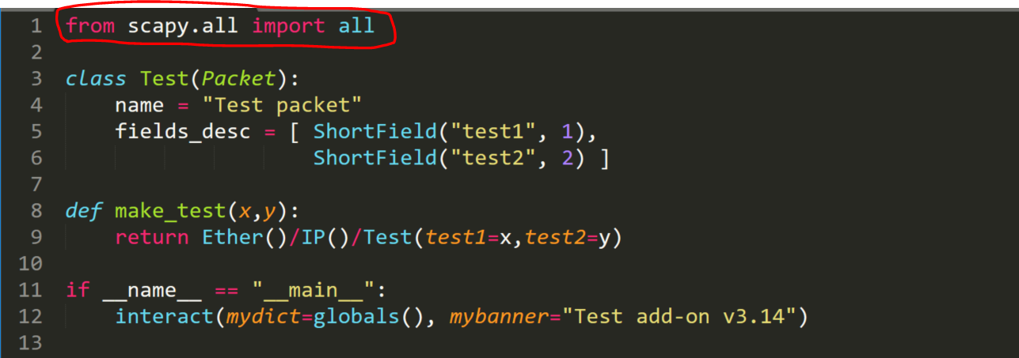
Importing Scapy
Notes:
Scapy.all holds all of the libraries we need.

Slide 7
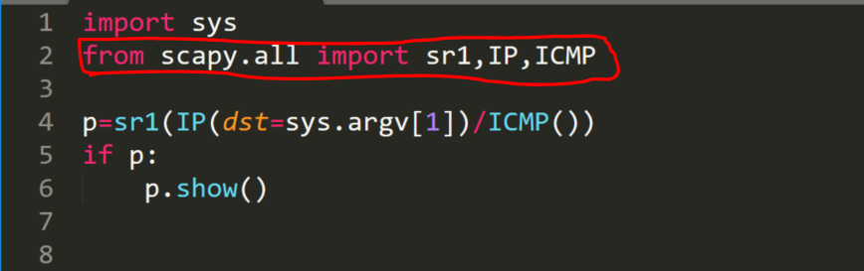
Importing Specific Modules

Slide 8
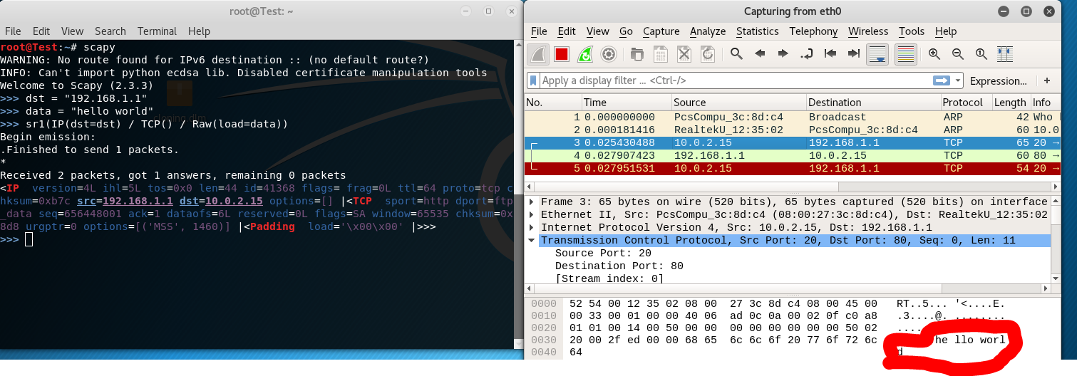
Simple TCP Request
Notes:
Show how simple it is to send a packet.
Let them try it too.

Slide 9
Request Structure
packet = sr1(IP(dst=“192.168.1.1”)/TCP()/Raw(“Hello World”))
Notes:
Explain that there is:
Sr1 – Waits for one answer from the host the packet was sent to.
Sr – Waits for multiple answers.
Send – Doesn’t list to an answer. Just sends.
Srp – Send packets and receive in layer 2
Srp1 – Send packets and receive one in layer2
/ - New layer

Slide 10
Let’s Add Flags
packet = sr1(IP(dst=“192.168.1.1”)/TCP(flags=“S”)/Raw(“Hello World”))
Notes:
Flags (all TCP flags):
SYN
ACK
FIN
CDR

Slide 11
Types of Requests
sr1 – Will send packets and receive only first the answer. (L3)
sr – Will send packets and receive all answers. (L3)
srp1 – Will send packets and receive only the first answer. (L2)
srp - Will send packets and receive all answers. (L2)
Notes:
Give an example where data that is returned is bigger then a packet can hold so it will send two.
L3 – IP, ARP, ICMP
L2 – Ethernet, 302.3

Slide 12
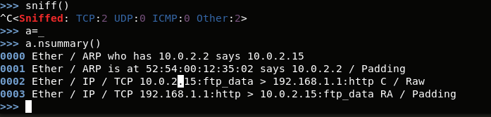
Sniffing
Notes:
Explain that the summary is passive sniffing and show the packets that came in.
Maybe here also show how a hub’s packets look vs switch.

Slide 13
Sniffing Filters
sniff(filter=“tcp port 110”)

Slide 14
Questions?

